Slide 1
Lecture 7: PIC16F877A Communication Protocol_USART
By Emmanuel

Slide 2
Agenda
Last lecture: Timers /Counters and Interrupts for PIC16f877A
Today’s Lecture:
Parallel data transfer Vs Serial data transfer
Addressable Universal Synchronous Asynchronous Receiver Transmitter (USART)
USART Registers for PIC16f877A
Baud Rate
Example of USART in practice (MPLAB & Proteus)

Slide 3
Classification
Data transfer method
Parallel Transfer
Faster
Expensive
Short distances (noise problem)
2. Serial Transfer
Slower
Cheaper
Short and long distances

Slide 4
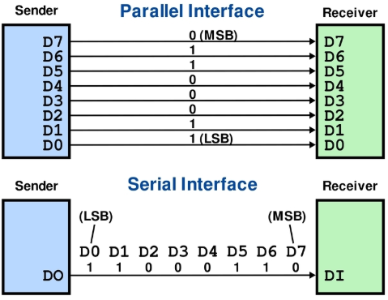
Parallel Vs Serial data transmission
Source: https://learn.adafruit.com/circuit-playground-express-serial-communications/what-is-seri-communications

Slide 5
Serial Data Transfer
Synchronous Asynchronous
Data
Formatted Data
Clock
Transmitter
Transmitter
Receiver
Receiver

Slide 6
Synchronous communication
The clock frequency along with the bits are transmitted
This means that the transmitter and the receiver are synchronized between them by the same clock frequency.
The information is transmitted in sequence
Fixed baud rate
Notes:
The synchronous serial link just described can be readily implemented in a microcontroller, as shown in
Figure 10.5. The clock source is placed in the microcontroller, and as the clock controls data flow, this node
is called the master. The other node is called the slave. The slave device could be another microcontroller,
a memory device or one of a range of other peripherals.

Slide 7
Asynchronous features
No clock transmitted
Data rate is predetermined – both transmitter and receiver are configured to recognize the same data rate.
Each node needs an accurate and stable clock source.
Each byte or word is framed with a start and stop bit. These allow synchronization to be initiated before the data starts to flow.
Notes:
The transmitter and the receiver refraining to broadcast long sequences of bits because there isn't a full synchronization between
the transmitter that sends the data and the receiver that receives the data. In this case, the information is divided into frames,
in the size of byte. Each one of the frame has a “Start” bit and a “Stop” bit. “Start” bit marks the beginning of a new frame,
“Stop” bit marks the end. Frames of information must not necessarily be transmitted at equal time space, since they are independent of the clock.

Slide 8
PIC16F87XA Serial Ports
MSSP: The Master Synchronous Serial Port is designed to support:
SPI: Serial Peripheral Interface (Motorola)
I²C: Inter-Integrated Circuit (Philips)
USART: Addressable Universal Synchronous Asynchronous Receiver Transmitter can operate in both synchronous and asynchronous modes.
RS-232

Slide 9
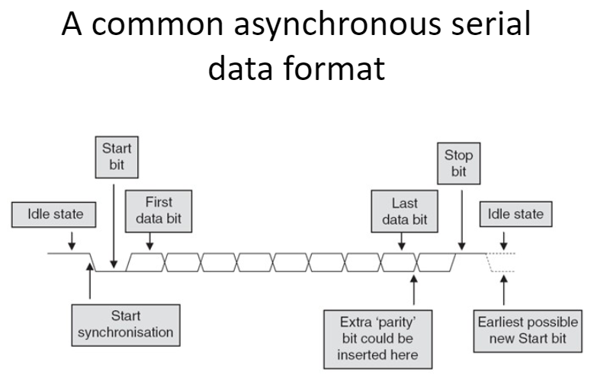
Source: https://slideplayer.com/slide/4899831/
Notes:
For synchronous communication, start and stop bits mark the start and the end of communication.

Slide 10
The 16F87XA USART
USART: Addressable Universal Synchronous Asynchronous Receiver Transmitter
Modes:
Synchronous master(Half-Duplex)
Synchronous slave(Half-Duplex)
Asynchronous full-duplex
Has receiver and transmit interrupts
Controlled by TXSA, RCSTA, and SPBRG
Notes:
Master : device transmitting
Slave: device receiving
master at a time/slave at a time

Slide 11
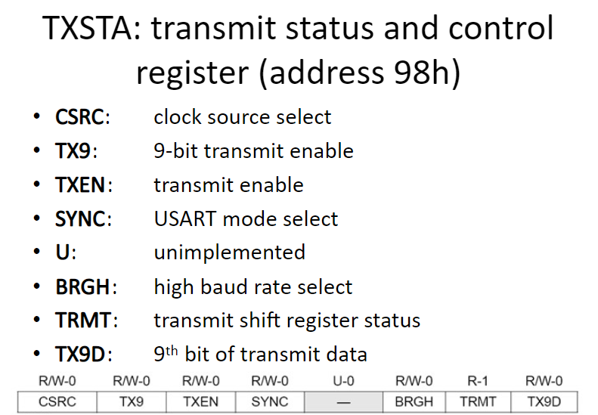
Source: https://www.teachmemicro.com/serial-usart-pic16f877a/
Notes:
CSRC for only synchronous communication
ASCII representation –8-bits
9th bits- party bit / also this bit could be used for addressing devices in the case we have multiple devices sharing data
In that case, when 9th bit is 1, the transmitted bits are addresses not data.

Slide 12
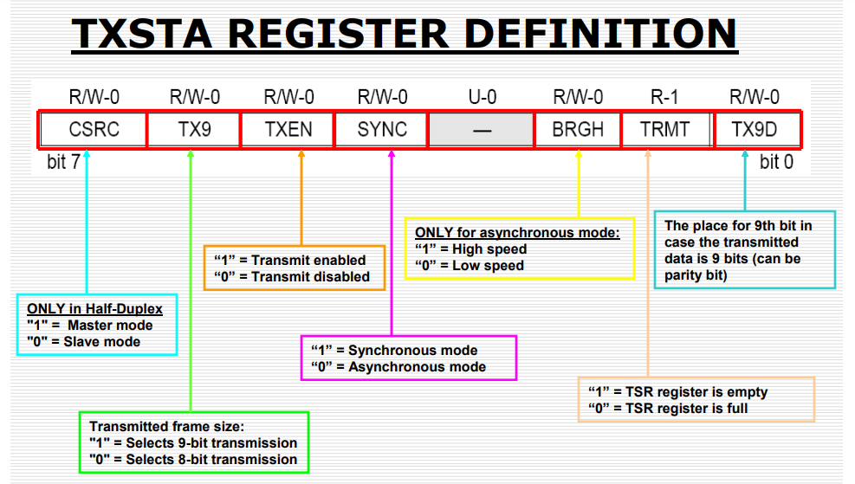

Slide 13
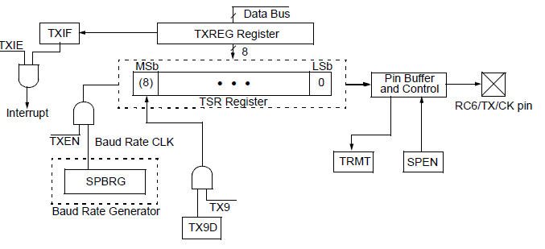
USART TRANSMIT BLOCK DIAGRAM

Slide 14
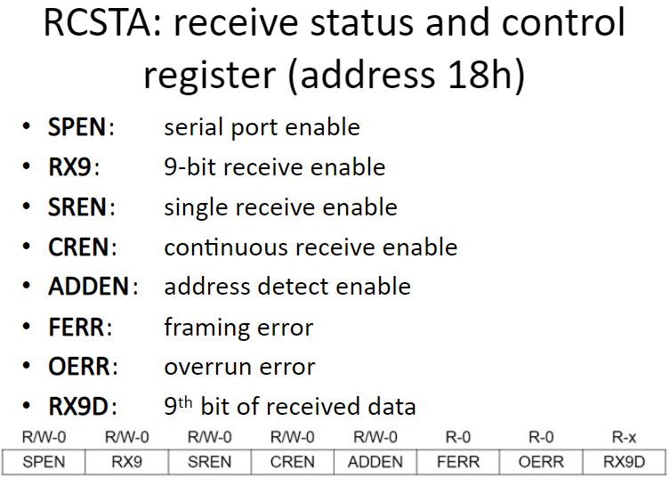
Source: https://www.teachmemicro.com/serial-usart-pic16f877a/
Notes:
FERR: is generated if there is a variation in stop bit. E.g. if the transmitter sends one stop bit and the receiver receives two stop bits, this is recorded as a framing error.
OERR: The external peripheral sends the second data before the processor empts the buffer register

Slide 15
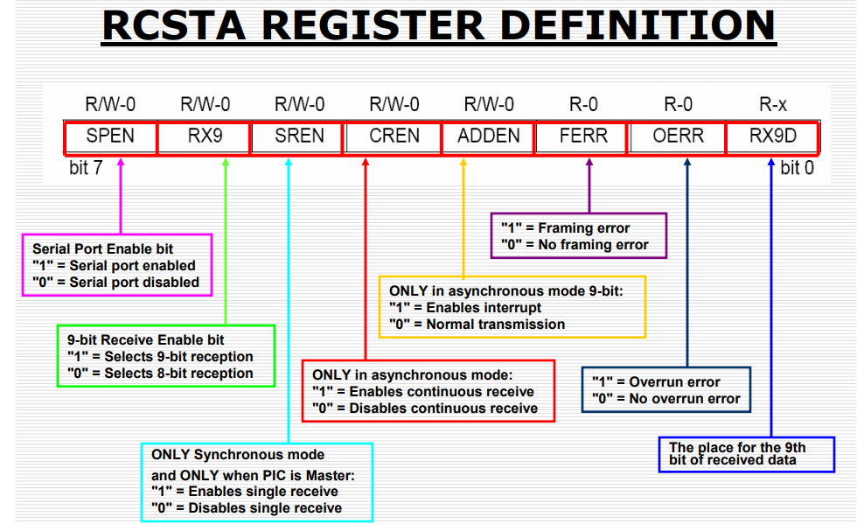

Slide 16
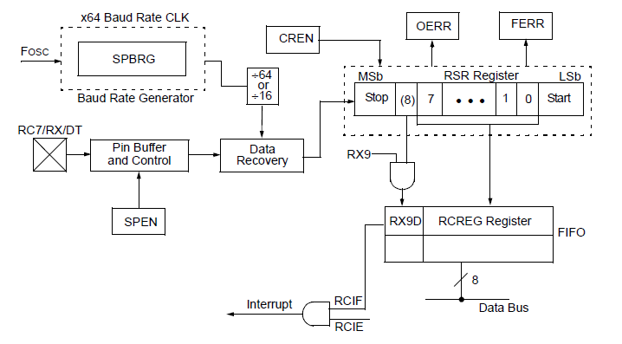
USART RECEIVE BLOCK DIAGRAM

Slide 17
Baud Rate
BAUD - baud rate
bps - units in which we are measuring pace of transmission
To set desirable baud rate (for example 9600 bps), it is necessary to determine a new value of a clock system. The value of the clock will be determined by the number inserted into register SPBRG.
The PIC can transmit at a high rate: BRGH=1 or at a low rate: BRGH=0.

Slide 18
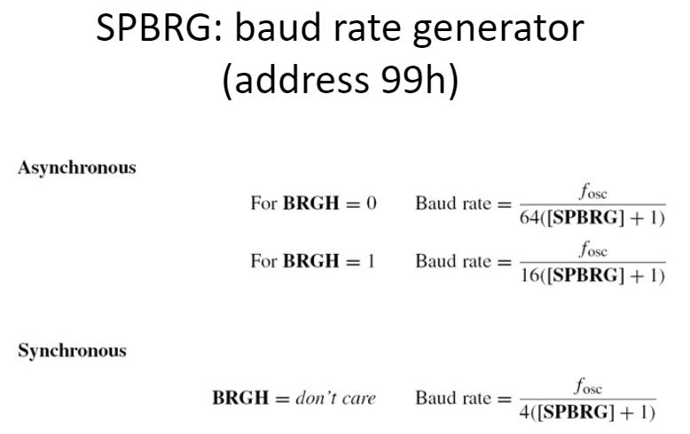

Slide 19
Example - calculating the value of the register SPBRG
Let’s calculate the decimal value to be insert into the register SPBRG, to get a transmission baud rate of 1200 bps at a lower rate.
We use the formula for a LOW SPEED (BRGH=0 – Low Speed):
SPBRG = (Fosc/(64 x Baud rate)) - 1
SPBRG = (4MHz/(64x1200bps))-1= 51.08, the value need to be as a whole number (no decimal point), thus the value of SPBRG = 51.

Slide 20
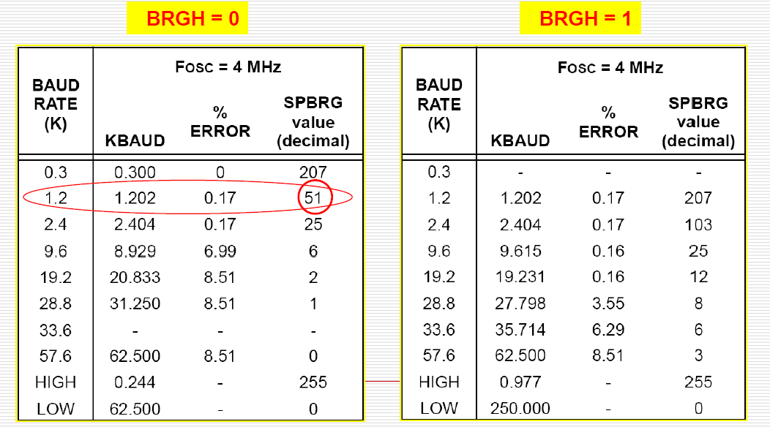

Slide 21
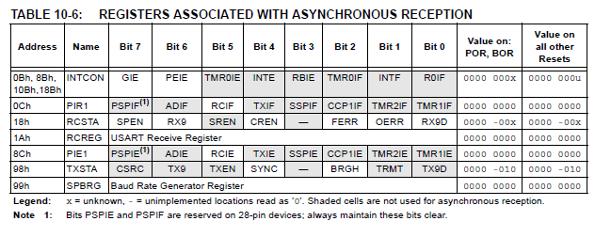
The interrupts associated with 16F87XA USART
Source: PIC16F87XA data-sheet, page 118

Slide 22
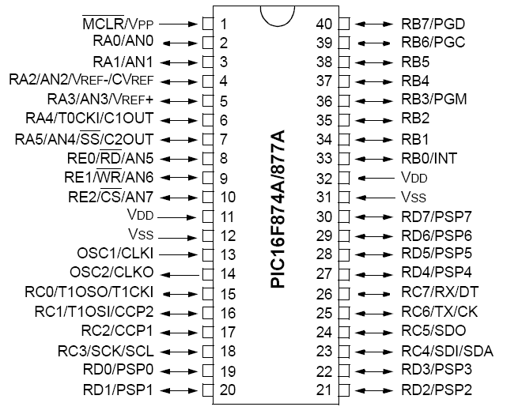
PIC16F877A pin-out
The microcontroller pins have multiple functions

Slide 23
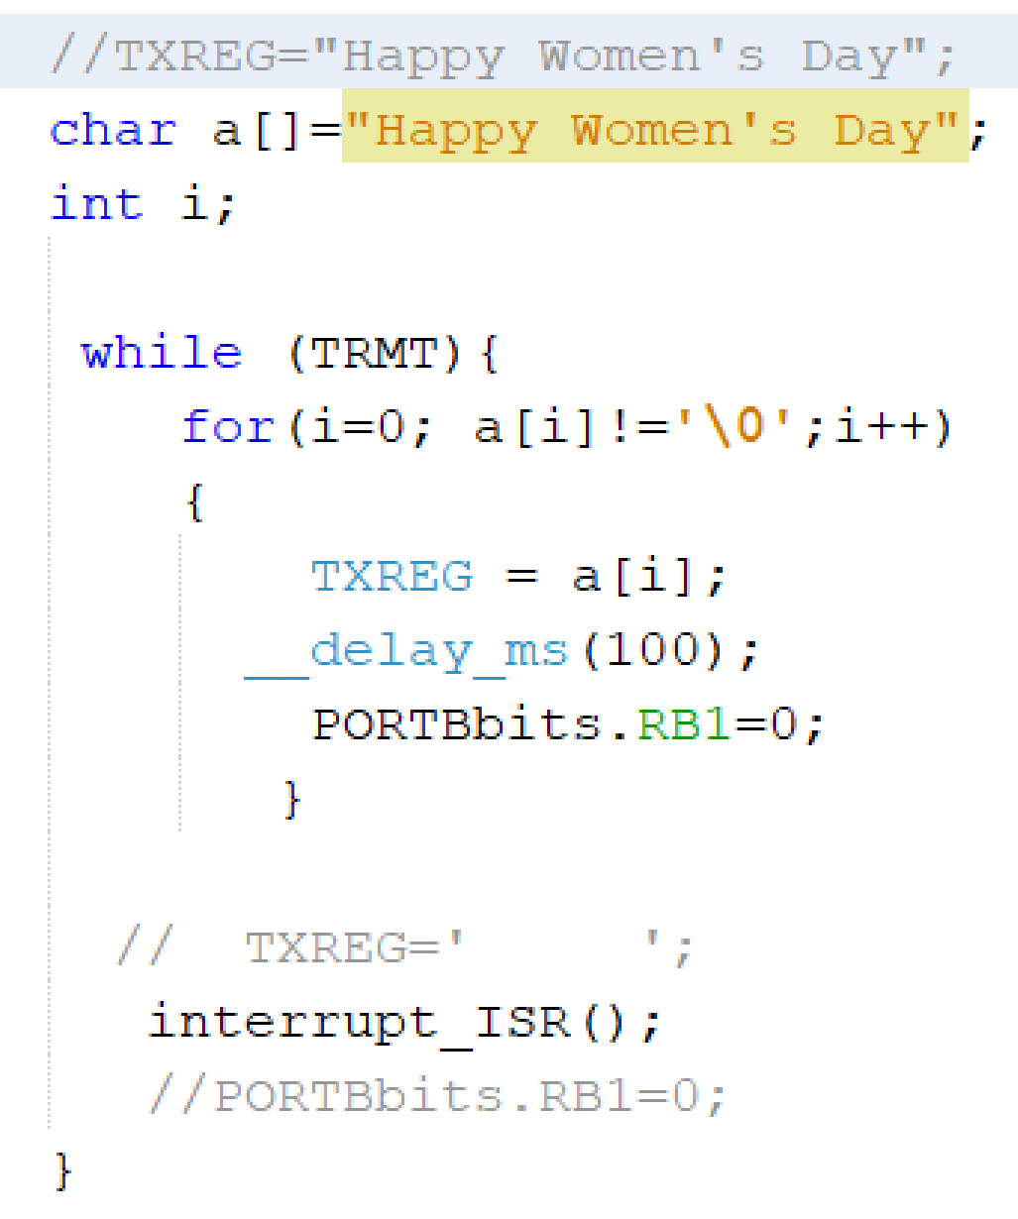
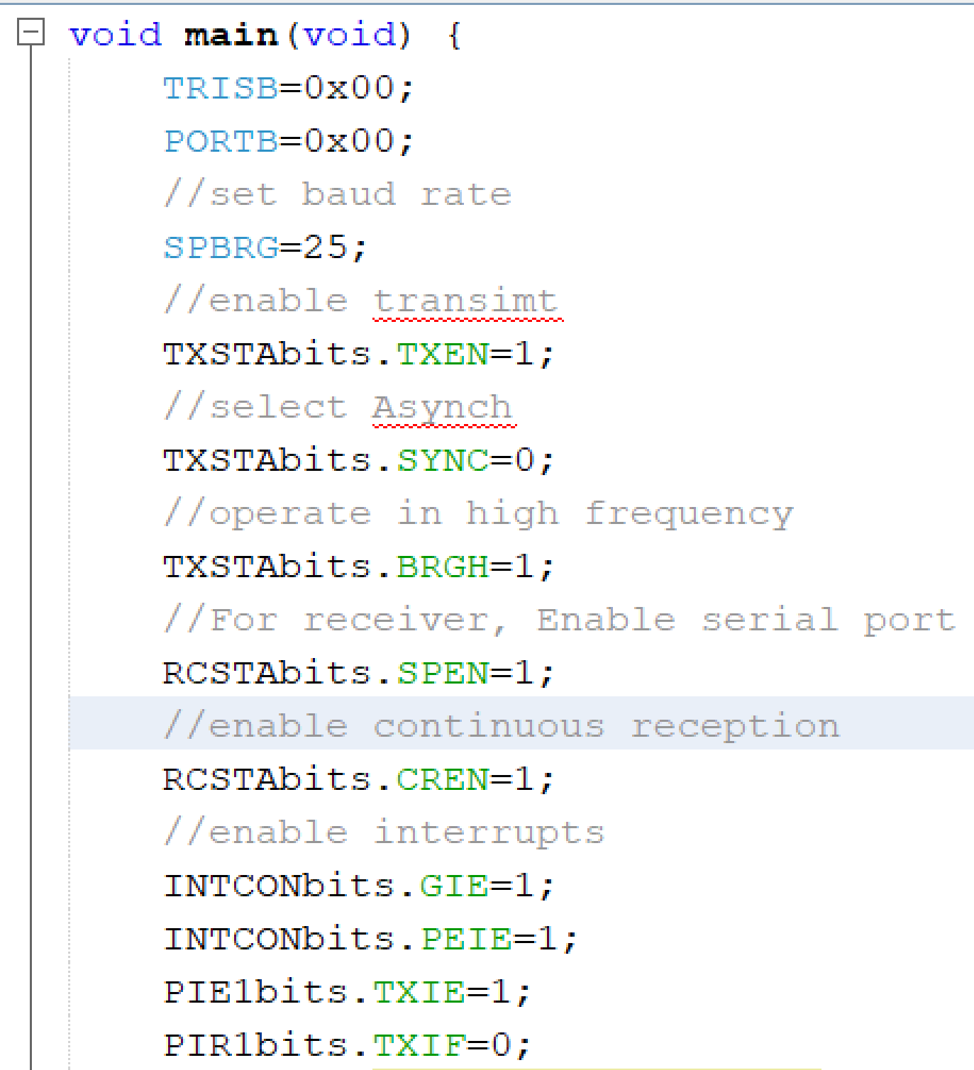
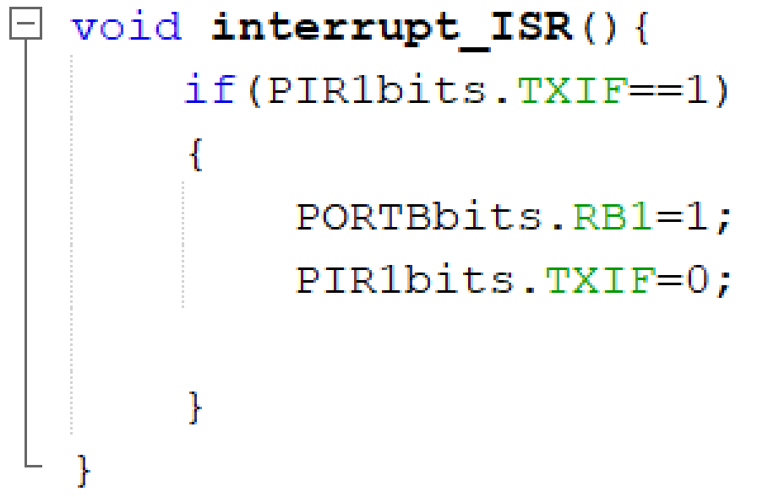
Program Example

Slide 24
Related articles
http://www.microcontrollerboard.com/support-files/serial_communication.pdf
http://www.windmill.co.uk/rs232-communication.html

Slide 25
Takeaway slide
Serial Communication
Asynchronous Vs Synchronous
PIC16F87XA USART registers
BAUD RATE
Interrupts associated with PIC16F87XA USART

